Slide 1
State Pattern
CS 399 Design Patterns with Java
Design Pattern GoF#20 - CS477 #2
Week #3
Week 3
State Pattern

Slide 2
Intent
Allow an object to alter its behavior when its internal state changes. The object will appear to change its class.(Go4)
Week 3
State Pattern

Slide 3
Dilemma
You need to dynamically “change the class of an object” -- this of course cannot be done, only faked.
You have a (ugly/huge/complex) conditional statement that chooses between actions based on field values.
You want to localize the selection of the dynamic behavior of an object.
Week 3
State Pattern

Slide 4
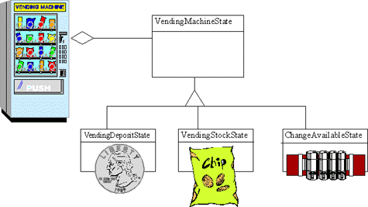
Conceptual Solution
Week 3
State Pattern

Slide 5
In Practice
Purpose
  OO finite state machine
  State inheritance hierarchy
  Current state wrapper
Calling Scenarios
  Components can morph their runtime behavior
  Switch statements are difficult to maintain - avoid!
  Finite state machine architecture - tables insufficient
Week 3
State Pattern

Slide 6
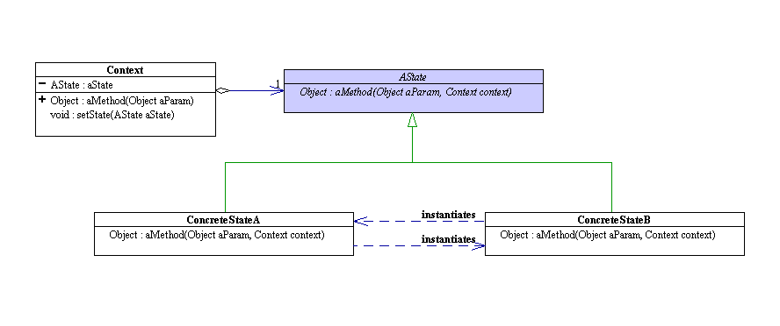
Structure
Week 3
State Pattern

Slide 7
State Pattern Examples
Car Wash
  Two states: Open or Closed
Finite State Automata
  Explicit implementation of abstract concept
Check Processing
  Handle all possible “states” of a check
Crosshairs program
  Instead of conditionals, change colors of the clicked squares with STATE pattern
Week 3
State Pattern

Slide 8


Car Wash State Pattern
Car Wash can be OPEN or CLOSED
Behaves differently based on State
OPEN – can get your car washed
CLOSED – cannot get car wash
Week 3
State Pattern

Slide 9
Car Wash State Pattern
Car Wash program BEFORE:
  Variable to store whether Car Wash is open
  Conditional based on variable
    Required everywhere an action is taken
  Lots of repeated code
  Difficult to maintain (for larger cases)
Week 3
State Pattern

Slide 10
Conceptual Behavior
Instead of having a conditional for each possible state, a separate, subclass is created.
With a context, the state objects transition between themselves, oblivious to the outside world.
Each object knows when and how to change state, and through “pointer” reassignment, can do so without informing client
Week 3
State Pattern

Slide 11
Car Wash State Pattern
Car Wash program AFTER:
  Object to store whether Car Wash is open
  No Conditionals!
  No repeated code
  Easy to maintain
    Loosely coupled – easy to extend
  Seems as though the class of the object has changed
Week 3
State Pattern

Slide 12
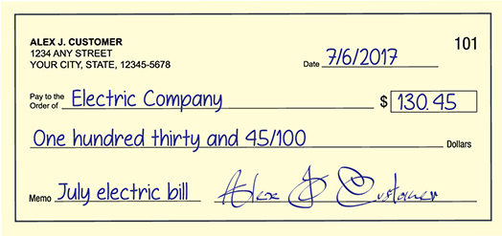
Check Processing Program
A check can have several possible states:
  Blank
  Unsigned
  Signed
  Endorsed
  Cashed
  Insufficient Funds
  Stop Payment
Week 3
State Pattern

Slide 13
cash
Blank
Endorsed
Cashed
fill in
endorse
bounce
sign
Unsigned
Signed
Insufficient
stop payment
stop payment
StopPayment
Week 3
State Pattern

Slide 14
public class BlankCheck extends Check{
public BlankCheck(CheckTransaction checkTransaction) { super(checkTransaction);
}
public void fillIn(String payee, Date date, double amount){ checkInfo = new CheckInfo(payee, date, amount); System.out.println("Check has been written");
Check unsignedCheck = new UnsignedCheck(checkTransaction); unsignedCheck.setCheckInfo(checkInfo); checkTransaction.updateTransaction(unsignedCheck);
}
Week 3
State Pattern

Slide 15
// public class BlankCheck extends Check{ (continued)
public void sign() {
System.out.println("It's quite foolish to sign a blank check");
}
public void endorse(){
System.out.println("It is unwise to endorse a blank check");
}
public void cash(){
System.out.println("Cannot cash a blank check");
}
public void stopPayment(){
System.out.println("Cannot stop payment on a blank check");
}
}
Week 3
State Pattern

Slide 16
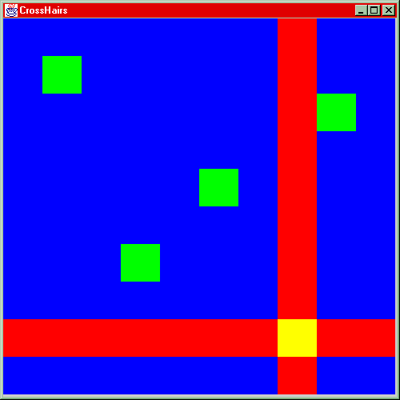
Crosshairs Example
Week 3
State Pattern

Slide 17
Crosshairs Implementation
Week 3
State Pattern

Slide 18
Crosshairs Example
ColorRetainer
BlueRetainer
GreenRetainer
returnColor
switchColor
returnColor
switchColor
Week 3
State Pattern

Slide 19
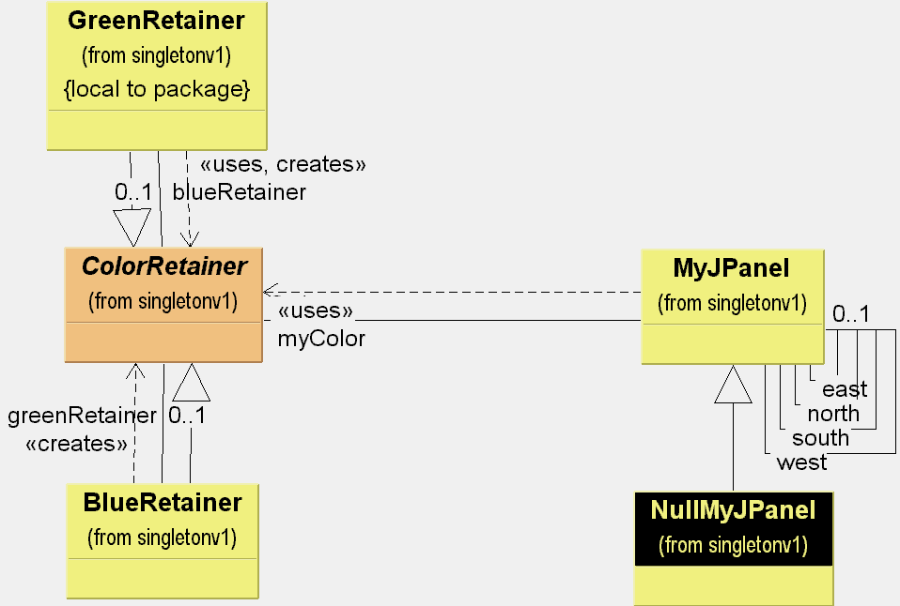
Week 3
State Pattern

Slide 20
Crosshairs Example
public abstract class ColorRetainer {
protected ColorRetainer colorRetainer;
public Color returnColor(){
return colorRetainer.getColor();
}
public abstract Color getColor();
public void switchColors(){
colorRetainer.swap();
}
public abstract void swap();
}
Week 3
State Pattern

Slide 21
public class BlueRetainer extends ColorRetainer{
private ColorRetainer greenRetainer;
public BlueRetainer() {
greenRetainer = new GreenRetainer(this);
}
public Color getColor(){
return Color.blue;
}
public void swap(){
colorRetainer = greenRetainer;
}
}
Week 3
State Pattern

Slide 22
public class GreenRetainer extends ColorRetainer{
private ColorRetainer blueRetainer;
public GreenRetainer(ColorRetainer blueRetainer) {
this.blueRetainer = blueRetainer;
}
public Color getColor(){
return Color.green;
}
public void swap(){
colorRetainer = blueRetainer;
}
}
Week 3
State Pattern

Slide 23
Conclusion
We can have internal or external state patterns.
  The two examples here are internal
  An external requires that the client know some things about the pattern (effectively they become the context)
Dramatically simplifies adding new states (augh - think of distributed conditional statements across the source code)
Week 3
State Pattern

Slide 24
Discussion
Can you think of examples where you’ve already used this pattern?
If something has only two to three states, is it overkill to use the State pattern?
Keep this one in mind…
  Foreshadowing: how does this pattern differ from the Strategy Pattern?
Week 3
State Pattern

